Slide 1

Sixth Edition
Chapter 1
Introduction, Acquiring Knowledge, and the Scientific Method

Slide 2
Some questions
What is the capital of the US?
What language is primarily spoken in Japan?
What temperature does water freeze at?
How do you know all these things are true?

Slide 3
Methods of Tenacity
What is tenacity?
  Information accepted as true because it has always been believed or because superstition supports it.
  Limitations: potential inaccuracies; no method for correcting erroneous ideas.

Slide 4
Methods of Intuition
What is intuition?
  Information accepted on the basis of a hunch.
  Limitation: no method for separating accurate from inaccurate knowledge.

Slide 5
Methods of Authority
Relies on information or answers from an expert in the field.
Good starting point—often quickest and easiest way to obtain answers.
Some limitations:
  Does not always provide accurate information.
  Often accepts expert’s statements as fact (method of faith).
  Not all “experts” are experts.

Slide 6
The Rational Method
What is an example of seeking answers by logical reasoning?
  All 3-year-old children are afraid of the dark.
  Amy is a 3-year-old girl.
  Therefore, Amy is afraid of the dark.
In the above argument:
  First two sentences are premise statements;
  Final sentence is a logical conclusion based on the premises.

Slide 7
Limitations to the Rational Method
Logical conclusions are only valid if the premise statements are true.
  The rational method “assumes” the premise statements are true.
People are not very good at logical reasoning.
  Sometimes the argument does not logically support the conclusion.

Slide 8
The Empirical Method
Also known as Empiricism:
  answering questions by direct observation or personal experience.
  Based on the philosophy that all knowledge is acquired through the senses.
Potential problems?

Slide 9
Problems with Empiricism?
Observations can be misinterpreted
Time-consuming
Sensory experience can be swayed by beliefs.
  Biased thinking!

Slide 10
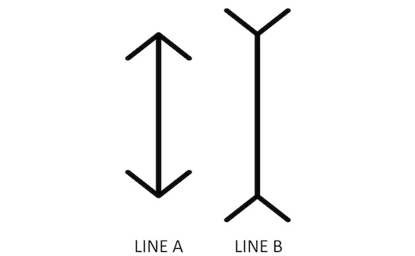

Slide 12
The Scientific Method
An approach to acquiring knowledge
  involves formulating specific questions and then systematically finding answers
  Combines several different methods of acquiring knowledge.

Slide 13
Science is Empirical and Public
Empirical: Based on structured or systematic observations.
Public: Observations are available for evaluation by others.
  Replication is key to the scientific method!
Objective: Outcome is not skewed by bias.

Slide 14
The Steps of the Scientific Method
Observe behavior or other phenomena.
Form a tentative answer or explanation (a hypothesis).
Use your hypothesis to generate a testable prediction.
Evaluate the prediction by making systematic, planned observations.
Use the observations to support, refute, or refine the original hypothesis.

Slide 15
Inductive and Deductive Reasoning
What is induction?
  A small set of specific observations is the basis for forming a general statement about a larger set of possible observations.
  Induction = increase
What is deduction?
  A general statement is the basis for reaching a conclusion about specific examples.
  Deduction = decrease

Slide 16
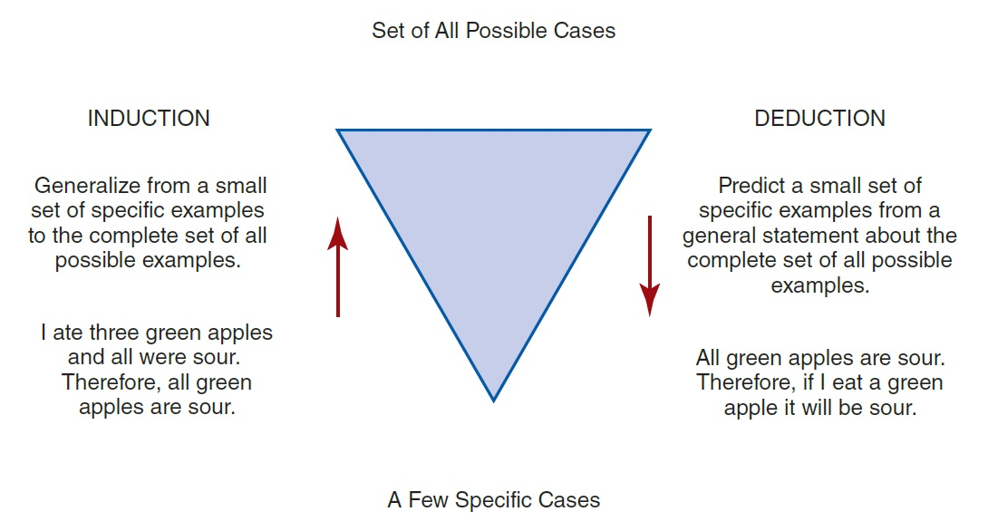
Examples of Induction and Deduction

Slide 17
Psychology as a Science (1)
Psychological Science = Theory + Data Collection + Data analysis
Analysis vs collection?
  Collection == experiment or observation
  Analysis == finding patterns in the data

Slide 18
Psychology as a Science
Often deal w/ Aggregates, Not Individuals
  The collective actions and situations of many individuals.
  Explain why aggregated patterns of behavior occur even if individuals might differ.
  How do individuals in general behave?

Slide 19
How do we describe observations?
Attributes = Characteristics or qualities that describe an object
  Examples: male, professor, 30, American, etc.
Variables = Groupings of attributes (think categories)
  Examples: gender, occupation, age, nationality, etc.
Attributes exist at individual level, variables at group level!

Slide 20
Variables and Hypothesis
Variables: characteristics or conditions that change or have different values for different individuals.
  Examples: weather, health status, and age.
What is a hypothesis?
  A statement that describes or explains a relationship between variables; “best guess.”
    A hypothesis can lead to several different observable and measureable predictions.
    Hypothesis must be testable!

Slide 21
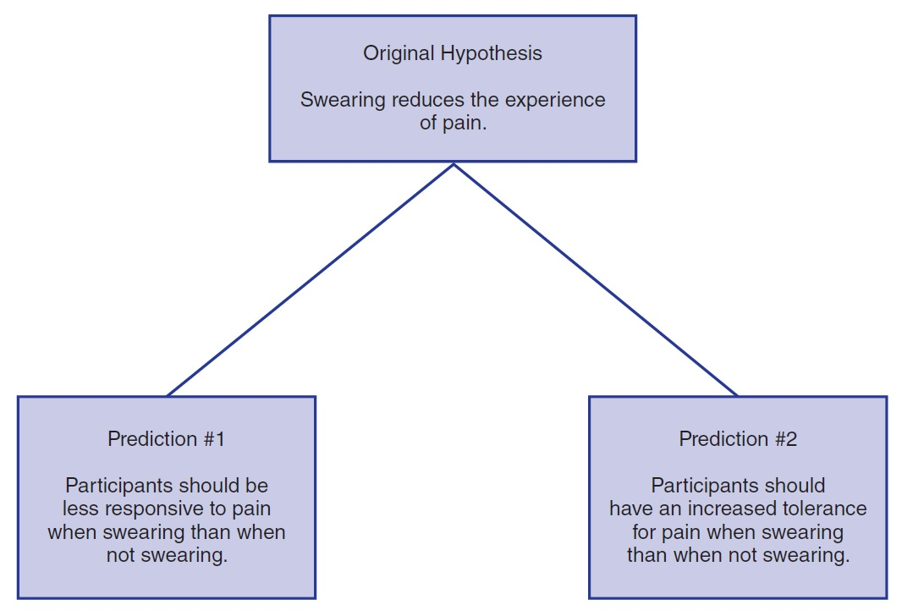
Two Testable Predictions Derived from a General Hypothesis

Slide 22
Science versus Pseudoscience
Basis of scientific research
  Evidence is gathered from careful, systematic, and objective observations.
Pseudoscience is a system of ideas often presented as science.
  Lacks some of the key components essential to scientific research.
  Examples?
Notes:
aromatherapy, astrology, phrenology

Slide 23
The Research Process
What distinguishes qualitative research and quantitative research?
  Quantitative research produces numerical scores.
    Submitted to statistical analysis for summary and interpretation
  Qualitative research is based on making observations.
    Summarized and interpreted in a narrative report

Slide 24
The Steps in the Research Process (1 of 2)
Find a research idea: select a topic and search the literature to find an unanswered question.
Form a hypothesis.
Determine how you will define and measure your variables.
Identify the participants for the study, decide how they will be selected, and plan for their ethical treatment.
Select a research strategy.

Slide 25
The Steps in the Research Process (2 of 2)
Select a research design.
Conduct the study.
Evaluate the data.
Report the results.
Refine or reformulate your research idea.

